Slide 1
SQL Server 2016 What’s New For Developers
Davide Mauri
info@davidemauri.it - @mauridb

Slide 2


Davide Mauri
Microsoft SQL Server MVP
Works with SQL Server from 6.5, on BI from 2003
Specialized in Data Solution Architecture, Database Design, Performance Tuning, High-Performance Data Warehousing, BI, Big Data
President of UGISS (Italian SQL Server UG)
Regular Speaker @ SQL Server events
Consulting & Training, Mentor @ SolidQ
E-mail: dmauri@solidq.com
Twitter: @mauridb
Blog: http://sqlblog.com/blogs/davide_mauri/default.aspx

Slide 3
SQL Server 2016
What’s new for developers?

Slide 4
A lot!
One of the biggest release since 2005, even for developers!

Slide 5
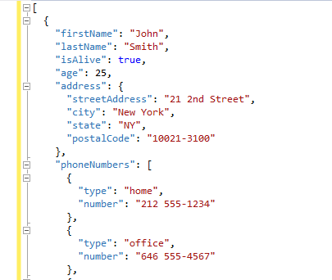
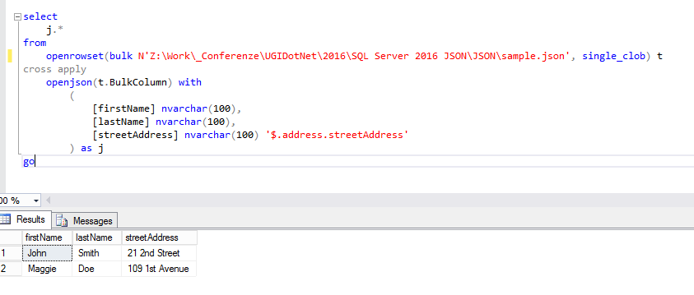
Love at first sight!
Native JSON Support

Slide 6
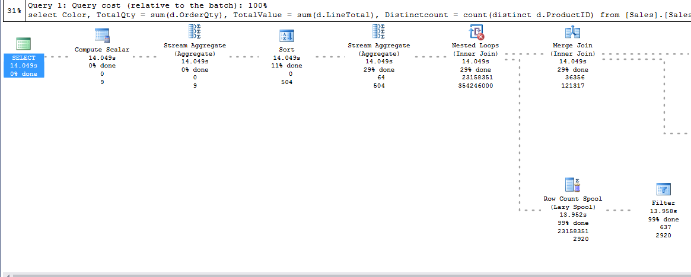
Love at first sight!
Live Query Statistics
Actual
Estimated

Slide 7
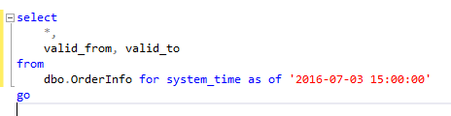
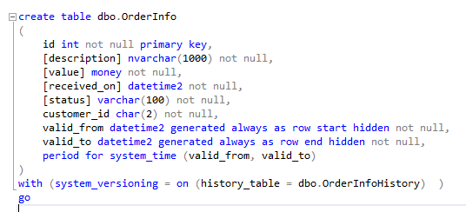

Love at first sight!
Temporal Tables

Slide 8
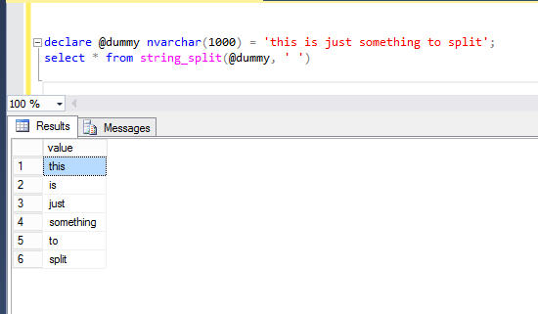
Warm & True Appreciation
DROP IF EXISTS
(GZIP) COMPRESS & DECOMPRESS
AT TIMEZONE
STRING_SPLIT

Slide 9
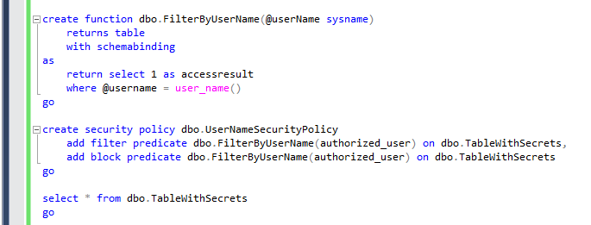
Yeah, good to know
Row Level Security

Slide 10
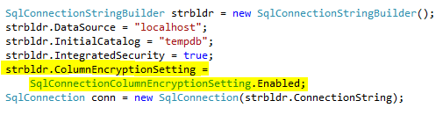
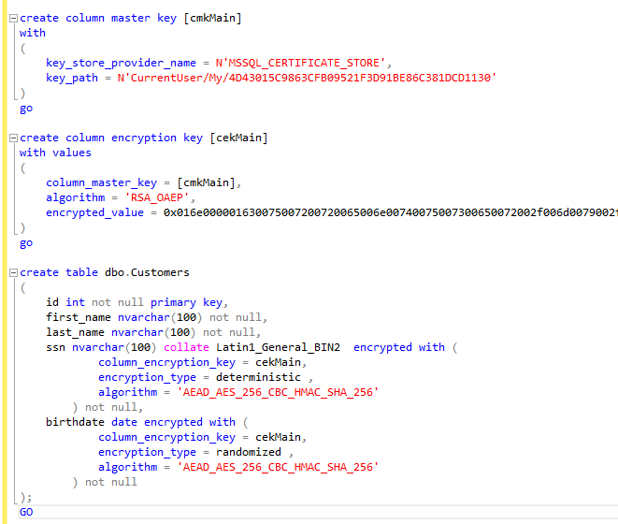
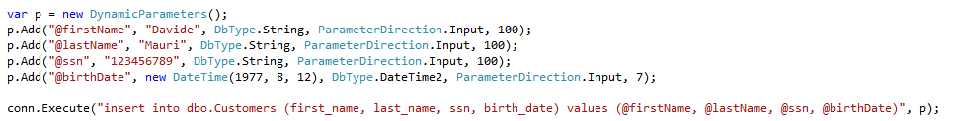
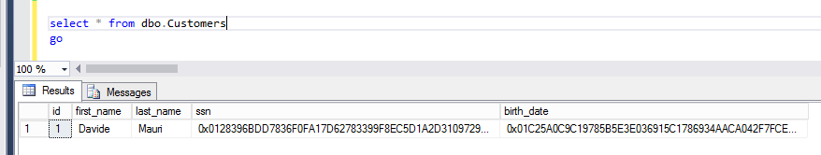
Yeah, good to know
Always Encrypted

Slide 11
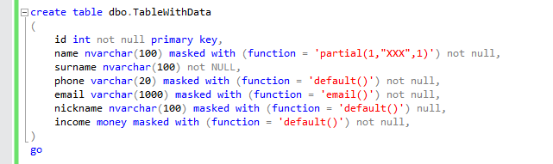
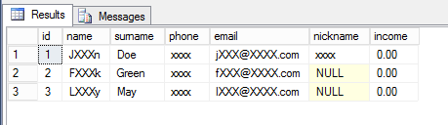
Yeah, good to know
Dynamic Data Masking

Slide 12
Yeah, good to know
Improved In-Memory Native Compiled Surface Area
CREATE PROCEDURE (Transact-SQL)
DROP PROCEDURE (Transact-SQL)
ALTER PROCEDURE (Transact-SQL)
SELECT (Transact-SQL) and INSERT SELECT statements
SCHEMABINDING and BEGIN ATOMIC (required for natively compiled stored procedures)
NATIVE_COMPILATION
Parameters and variables can be declared as NOT NULL
Table-valued parameters
EXECUTE AS OWNER, SELF, and user
GRANT and DENY permissions on tables and procedures
Nesting natively compiled stored procedures
RIGHT OUTER JOIN, LEFT OUTER JOIN, INNER JOIN, and CROSS JOIN in SELECT statements
NOT, OR, and IN operators in SELECT, UPDATE and DELETE statement
UNION ALL and UNION
SELECT DISTINCT
GROUP BY clause with no aggregate functions in the SELECT clause (<select> list)
COLUMNSTORE
COLLATE

Slide 13
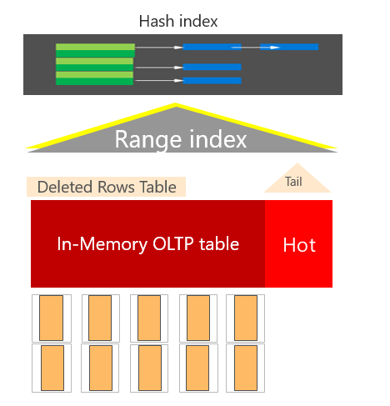
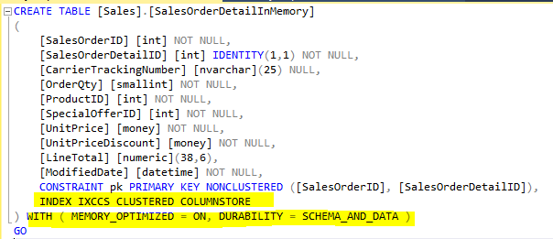
Yeah, good to know
Columnstore Indexes (clustered & non-clustered, on-disk & in-memory)

Slide 14
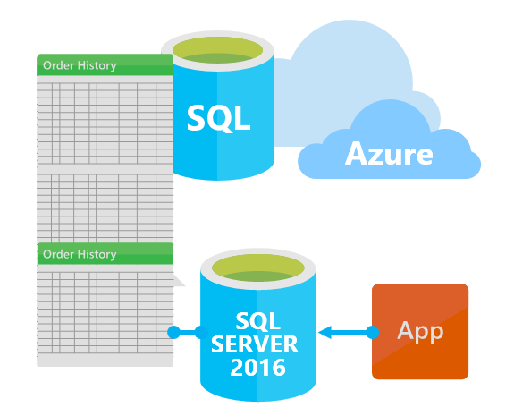
Yeah, good to know
Stretch Database

Slide 15
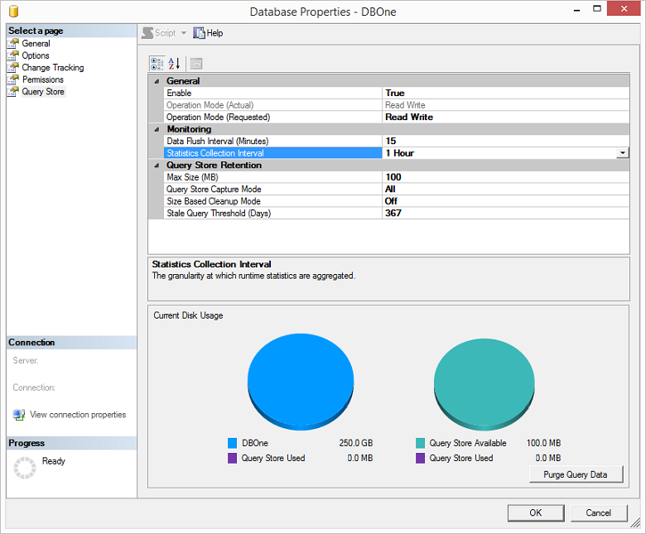
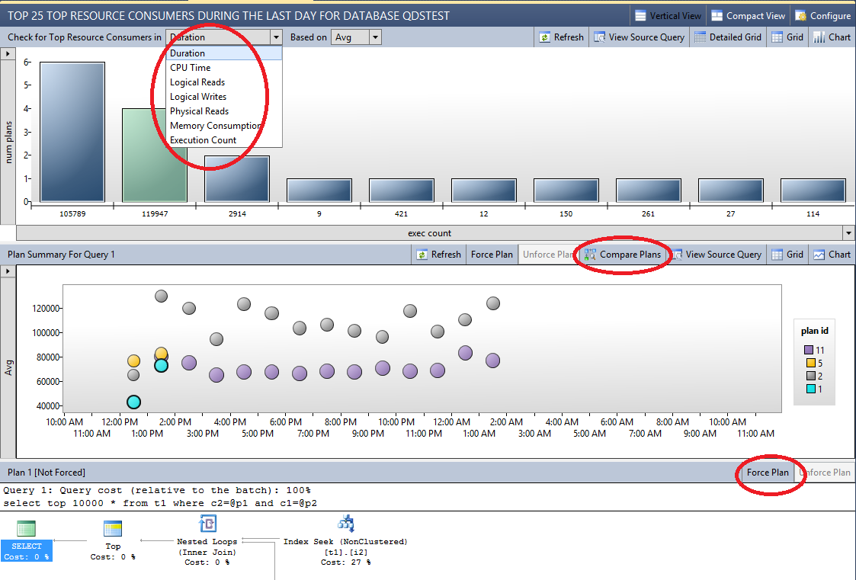
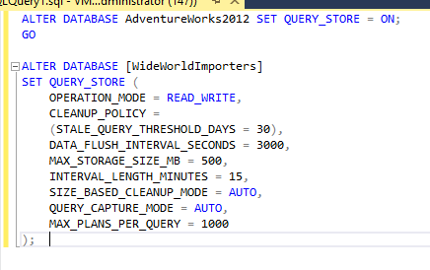
Couldn’t care less…but still interesting
Query Store

Slide 16
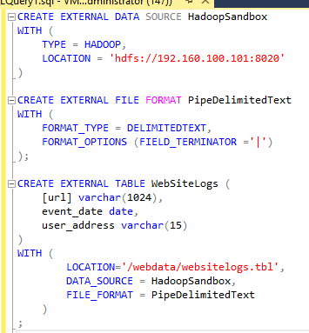
Couldn’t care less…but still interesting
Polybase
Query relational and non-relational data, on-premises and in Azure
T-SQL query
SQL Server
Hadoop
Apps

Slide 17
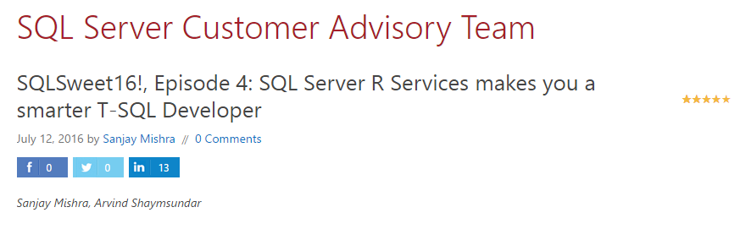
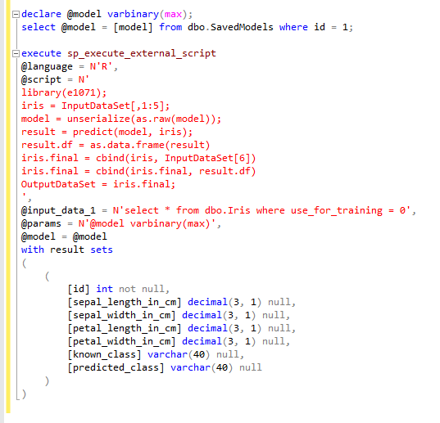
Couldn’t care less…but still interesting
R Stats Integration

Slide 18
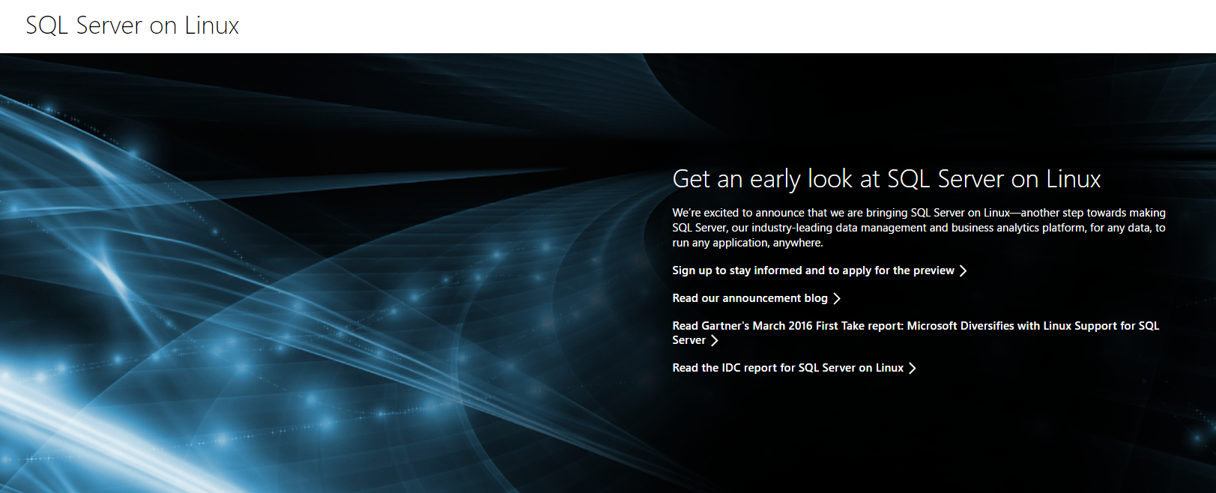
SQL Server on Linux!
https://www.microsoft.com/en-us/cloud-platform/sql-server-on-linux

Slide 19
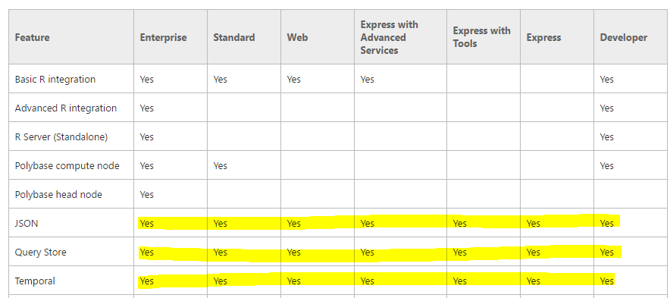
Which edition do I need?
https://msdn.microsoft.com/en-us/library/cc645993.aspx#Programmability

Slide 20
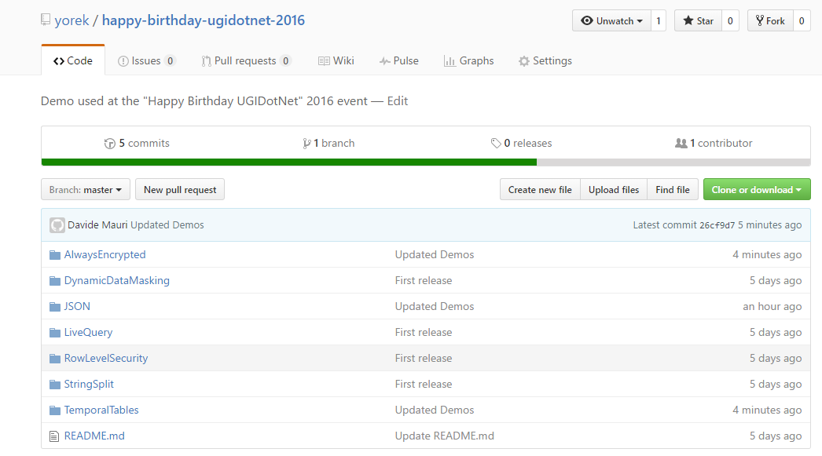
Demos
https://github.com/yorek/happy-birthday-ugidotnet-2016

Slide 21
Thank you! Questions?
https://twitter.com/ugidotnet

